Slide 1
Core Assessment Overview
Presentation by the
Office of Institutional Research and Effectiveness

Slide 2
The Core Curriculum at Georgia College
Beginning in FY19, GC redesigned its core curriculum to create a highly intentional, deliberate, innovative general education program of study that is deeply grounded in the tenants of the liberal arts. While traditional core courses teach specific institutional learning outcomes, GC’s core courses also each align to one of the American Association of Colleges & Universities (AAC&U) Essential Learning Outcomes (ELOs). These outcomes are liberal arts based and focus on critical postsecondary knowledge, skills, and dispositions that employers most desire in college graduates entering the workforce.
Knowledge of Human Cultures and the Physical and Natural World
Intellectual and Practical Skills
Personal and Social Responsibility
Integrative and Applied Learning
https://www.aacu.org/trending-topics/essential-learning-outcomes
https://irout.gcsu.edu/assessment20/core.html

Slide 3
What is the purpose?
University System of Georgia (USG) requirement:
https://www.usg.edu/policymanual/section3/C338
“The specific learning outcomes for areas A through E of an institution’s core curriculum are approved by the Council on General Education.”
“Assessment of the core curriculum by each institution is required as part of their accreditation by the Southern Association of Colleges and Schools and by the USG Comprehensive Program Review process.”
Fulfills the General Education requirement established by SACSCOC:

Slide 4
Who is involved?
All faculty assigned to teaching responsibilities in the core curriculum Areas A-E:
Assess student assignments
Submit assessment data to OIRE
Office of Institutional Effectiveness staff:
Coordinates process
Analyzes data
Publishes results
Writes and submits reports to USG, SACSCOC, other external entities upon request

Slide 5
What are the procedures?
Know and understand the GC core and AAC&U ELO’s associated with the course you are assigned to teach!
Include these outcomes on your syllabus. Talk about them with your students.
Review the rubric specific to the outcomes associated with the core course(s) you are teaching.
Choose a pre-existing assignment(s) that will demonstrate the students’ achievement of the outcome associated with the course.
Await student sample list for assessment (if applicable).
Assess students’ work using appropriate rubric.
Enter data into Qualtrics.

Slide 6
Can I view/use the results? Where?
Yes!
Results are reported by SLO/AAC&U Outcome on our website.
https://irout.gcsu.edu/assessment20/core.html

Slide 7
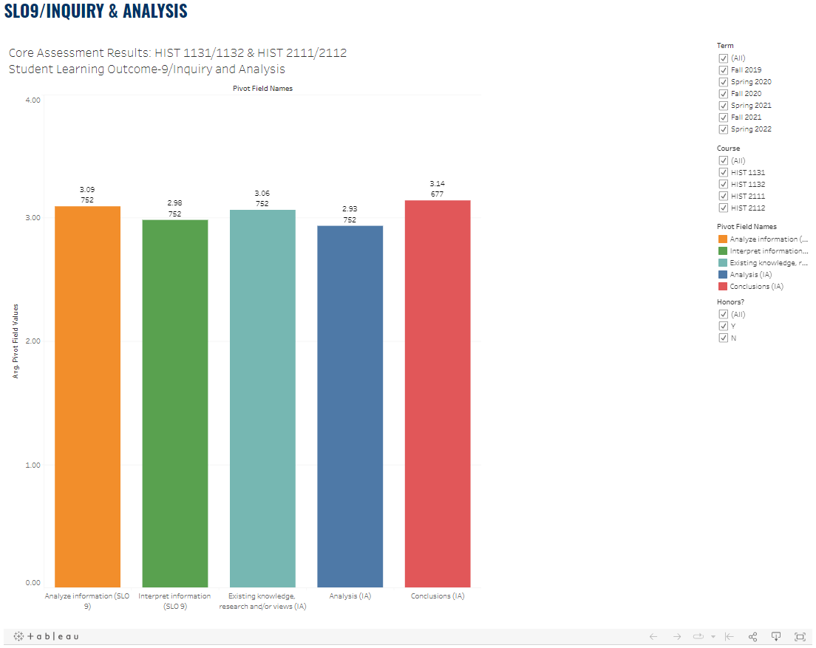

Slide 8
FAQs
I do not have one single assignment that encompasses all Student Learning Outcomes. What do I do?
You can assess learning outcome on the rubric using a different assignments, or you can split it (ie. 2/3). Please note this in the assignment description box when you submit the assessment.
I use an assignment given close to mid-term to assess. Can I submit prior to the deadline?
Yes, you can submit throughout the semester. I wait until after drop/add to send samples, but you may request your sample early or assess all students.
Can I use the rubric for my own grading purposes?
Yes, absolutely!
But I don’t have to share the rubric assessment results with students?
You can but you don’t have to. The main purpose of core assessment practices are for the university to demonstrate that students are meeting our specific core curriculum outcomes.
What if a student on my sample list did not complete the assignment I use to assess?
Please replace that student with a student who did complete the assignment.

Slide 9
Communication Schedule
Course Rotation Schedule is published on our website
First week of class: initial notification that you are teaching a course on the current core rotation schedule, deadline info
October/March: Samples: individual email containing a sample of students in each section that you are to assess
The only exception to sampling is faculty teaching one section of GC1Y/GC2Y. Please assess all students.
November/April: Deadline Reminder
December/May: Deadline Reminder

Slide 10
Support and Contact Information
Office of Institutional Effectiveness
Cara Smith, Director of Institutional Effectiveness
cara.smith@gcsu.edu
x3530
Lauren Farmer, Research Analyst
lauren.farmer@gcsu.edu
x3350
Located in the Harrison House
Available and happy to meet in-person or virtually, one-on-one, or in a group setting
This presentation will be published on our website for reference.

